Slide 1
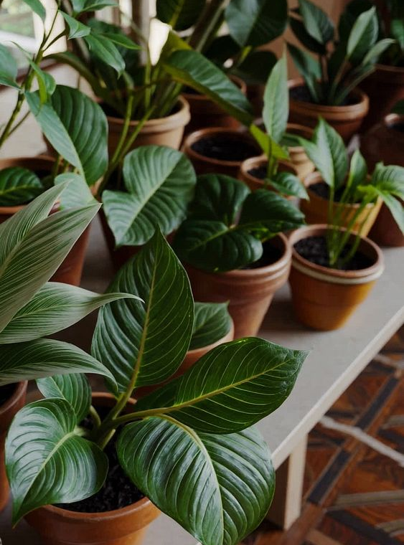
Smart plant monitor
Team:
Ahmed Mekky
Moamen Hamed
Ziyad Abdul Jameel
Emad Eldeen

Slide 2
The problem
We noticed that people don’t always know what is the temperature and humidity that their plants need , and if they knew, they will not be always beside their plants to measure the temperature and humidity.

Slide 3
The Solution
We designed a device using the ESP32 to measure the temperature and humidity of chosen plants periodically. It alerts the user if the temperature was too high or too low than needed while measuring the humidity and display the status of the current plant environment (too low , suitable or too high) .

Slide 4
How it works
Our device uses the ESP32 microcontroller as the processor.
First, the DHT22 sensor measures the temperature and humidity.
Then, the user is asked to choose a plant from preset profiles.
After that, the program uses if/else if/else conditional statements to determine the environment status.
Then, all of plant name, temperature, humidity, and status get displayed in the terminal and on an OLED display.
If the status is “too high”, the red LED lights up and the buzzer turn on at 1000 hertz (frequency).
The buzzer acts as the fan since there is no fan actuator in wokwi.
If the status is “too low”, only the red LED turns on.
If the status is “suitable”, only the green LED turns on.

Slide 5
The components used
ESP32: the microcontroller (processor).
DHT22: the temperature and humidity sensor (connected through VCC , GND.2 and GPIO 4).
Green LED (led_1): “suitable status” LED (connected to GND.1 and GPIO 32).
Red LED (led_2): “too low” or “too high” LED (connected to GND.1 and GPIO 2).
Buzzer: turns on if the status is “too high” (connected to GND.1 and GPIO 27).
OLED screen: displays plant name, temperature and humidity (connects to GND.2 , GPIO 22(SCL), GPIO 21 (SDA) and VCC for power).
Note: all the components are wired as instructed in the pdf by eyouth.

Slide 6
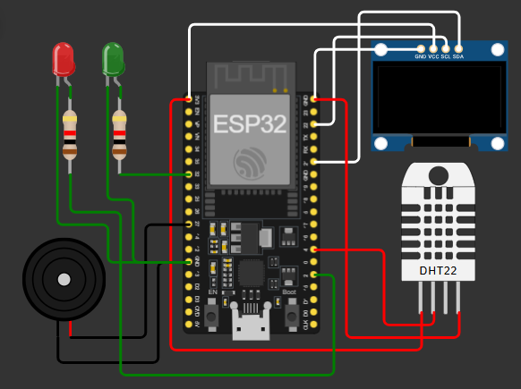

Project design
Project diagram was made in wokwi.

Slide 7
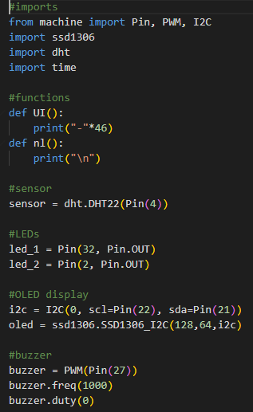
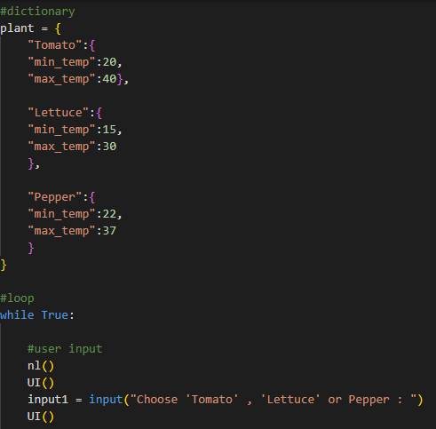
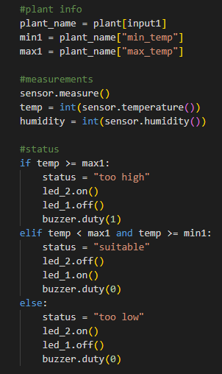
Main.py

Slide 8
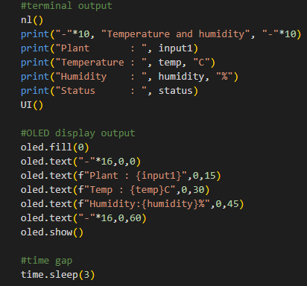
Main.py

Slide 9
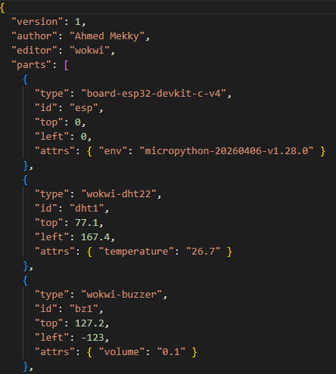
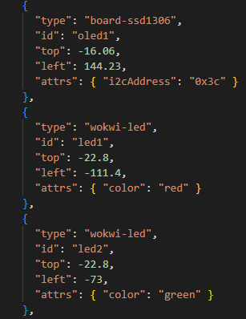
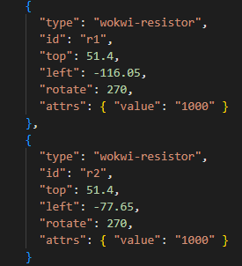
Diagram.json

Slide 10
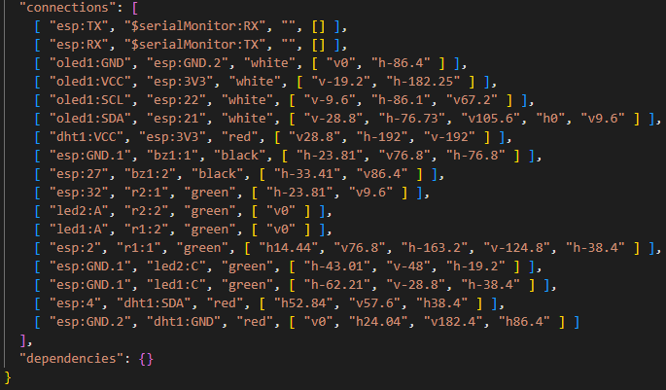
Diagram.json

Slide 11
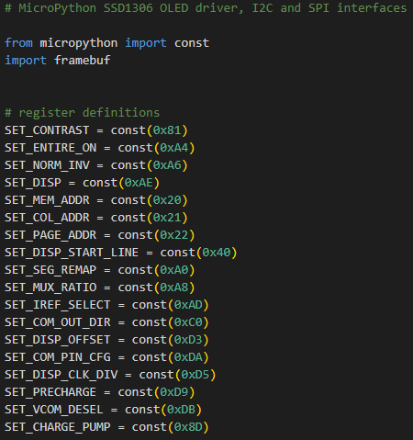
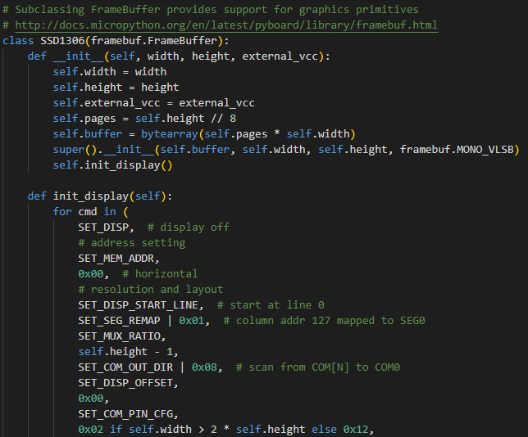
Ssd1306.py

Slide 12
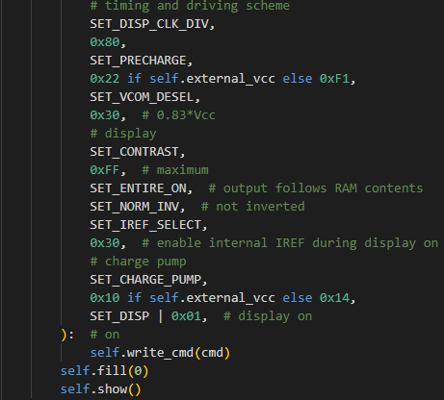
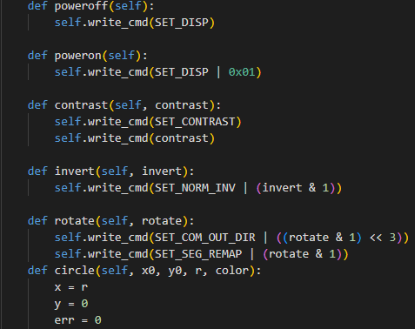
Ssd1306.py

Slide 13
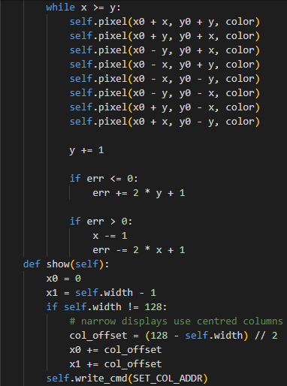
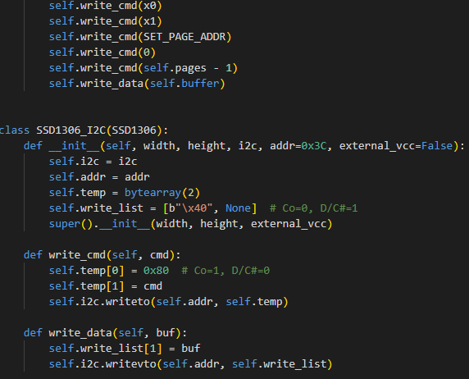
Ssd1306.py

Slide 14
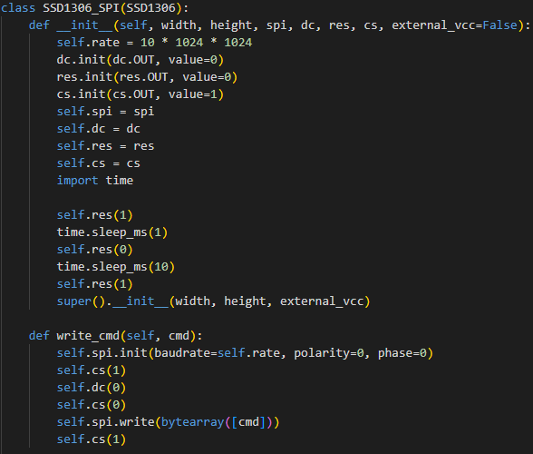
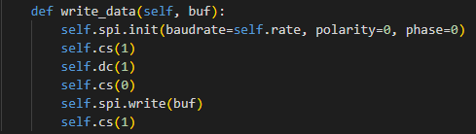
Ssd1306.py

Slide 15
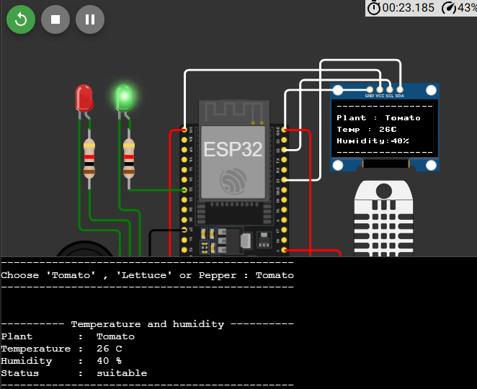
Output
After the user chooses a plant, the program displays its name, temperature and humidity in both the terminal and the OLED display.
The status is only displayed in the terminal.
Since the temperature is in the suitable range, only the green LED lights up.
You can change the temperature to get different results.

Slide 16
Testing and challenges
We tested and enhanced the device several times before agreeing on the final model.
The only challenge we faced is that the OLED display didn’t have enough space to display the plant name, temperature, humidity and status without damaging the UI, so we decided to only display the status in the terminal.

Slide 17
Final Result
The device has preset plant profiles that include the plant name, minimum temperature and max temperature.
The user is asked to choose a plant to make the measurements against this plant’s values.
After the status is determined, a certain LED turns on, and the buzzer turns on if the status is “too high”.
The plant name, current temperature and current humidity are displayed in both the terminal and the OLED display.
The current environment status is displayed only in the terminal.
All the components are wired as instructed.
Project link: https://wokwi.com/projects/474161109420699649

Slide 18
Conclusion
Through dedication, hard work, and team effort, we succeeded in making a smart plant monitor that tracks the temperature and humidity of plants and alerts the user if status of the plant environment is not “suitable”.
The project could be improved externally if we used a 3D printer to make a shell for the device, so it looks good.

Slide 19
THANK YOU

